Slide 1
ML Pipelines
with Kedro > Prefect

Slide 2
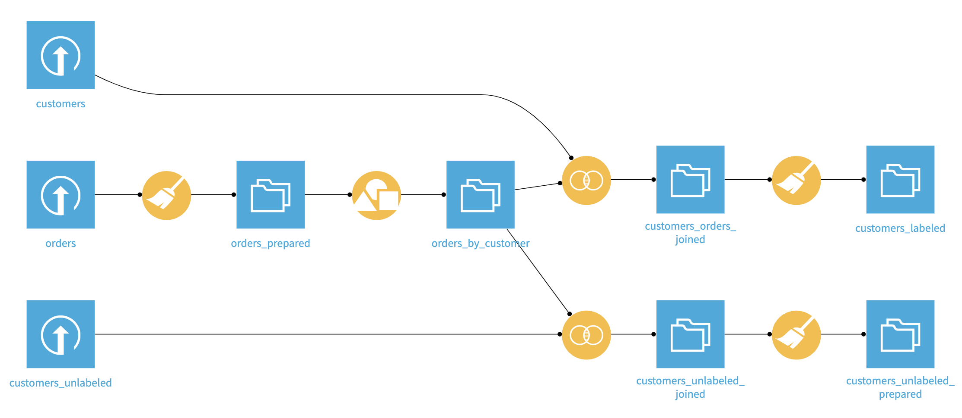
HighRev
Predict HighRevenue Customers - Dataiku

Slide 3


Slide 4
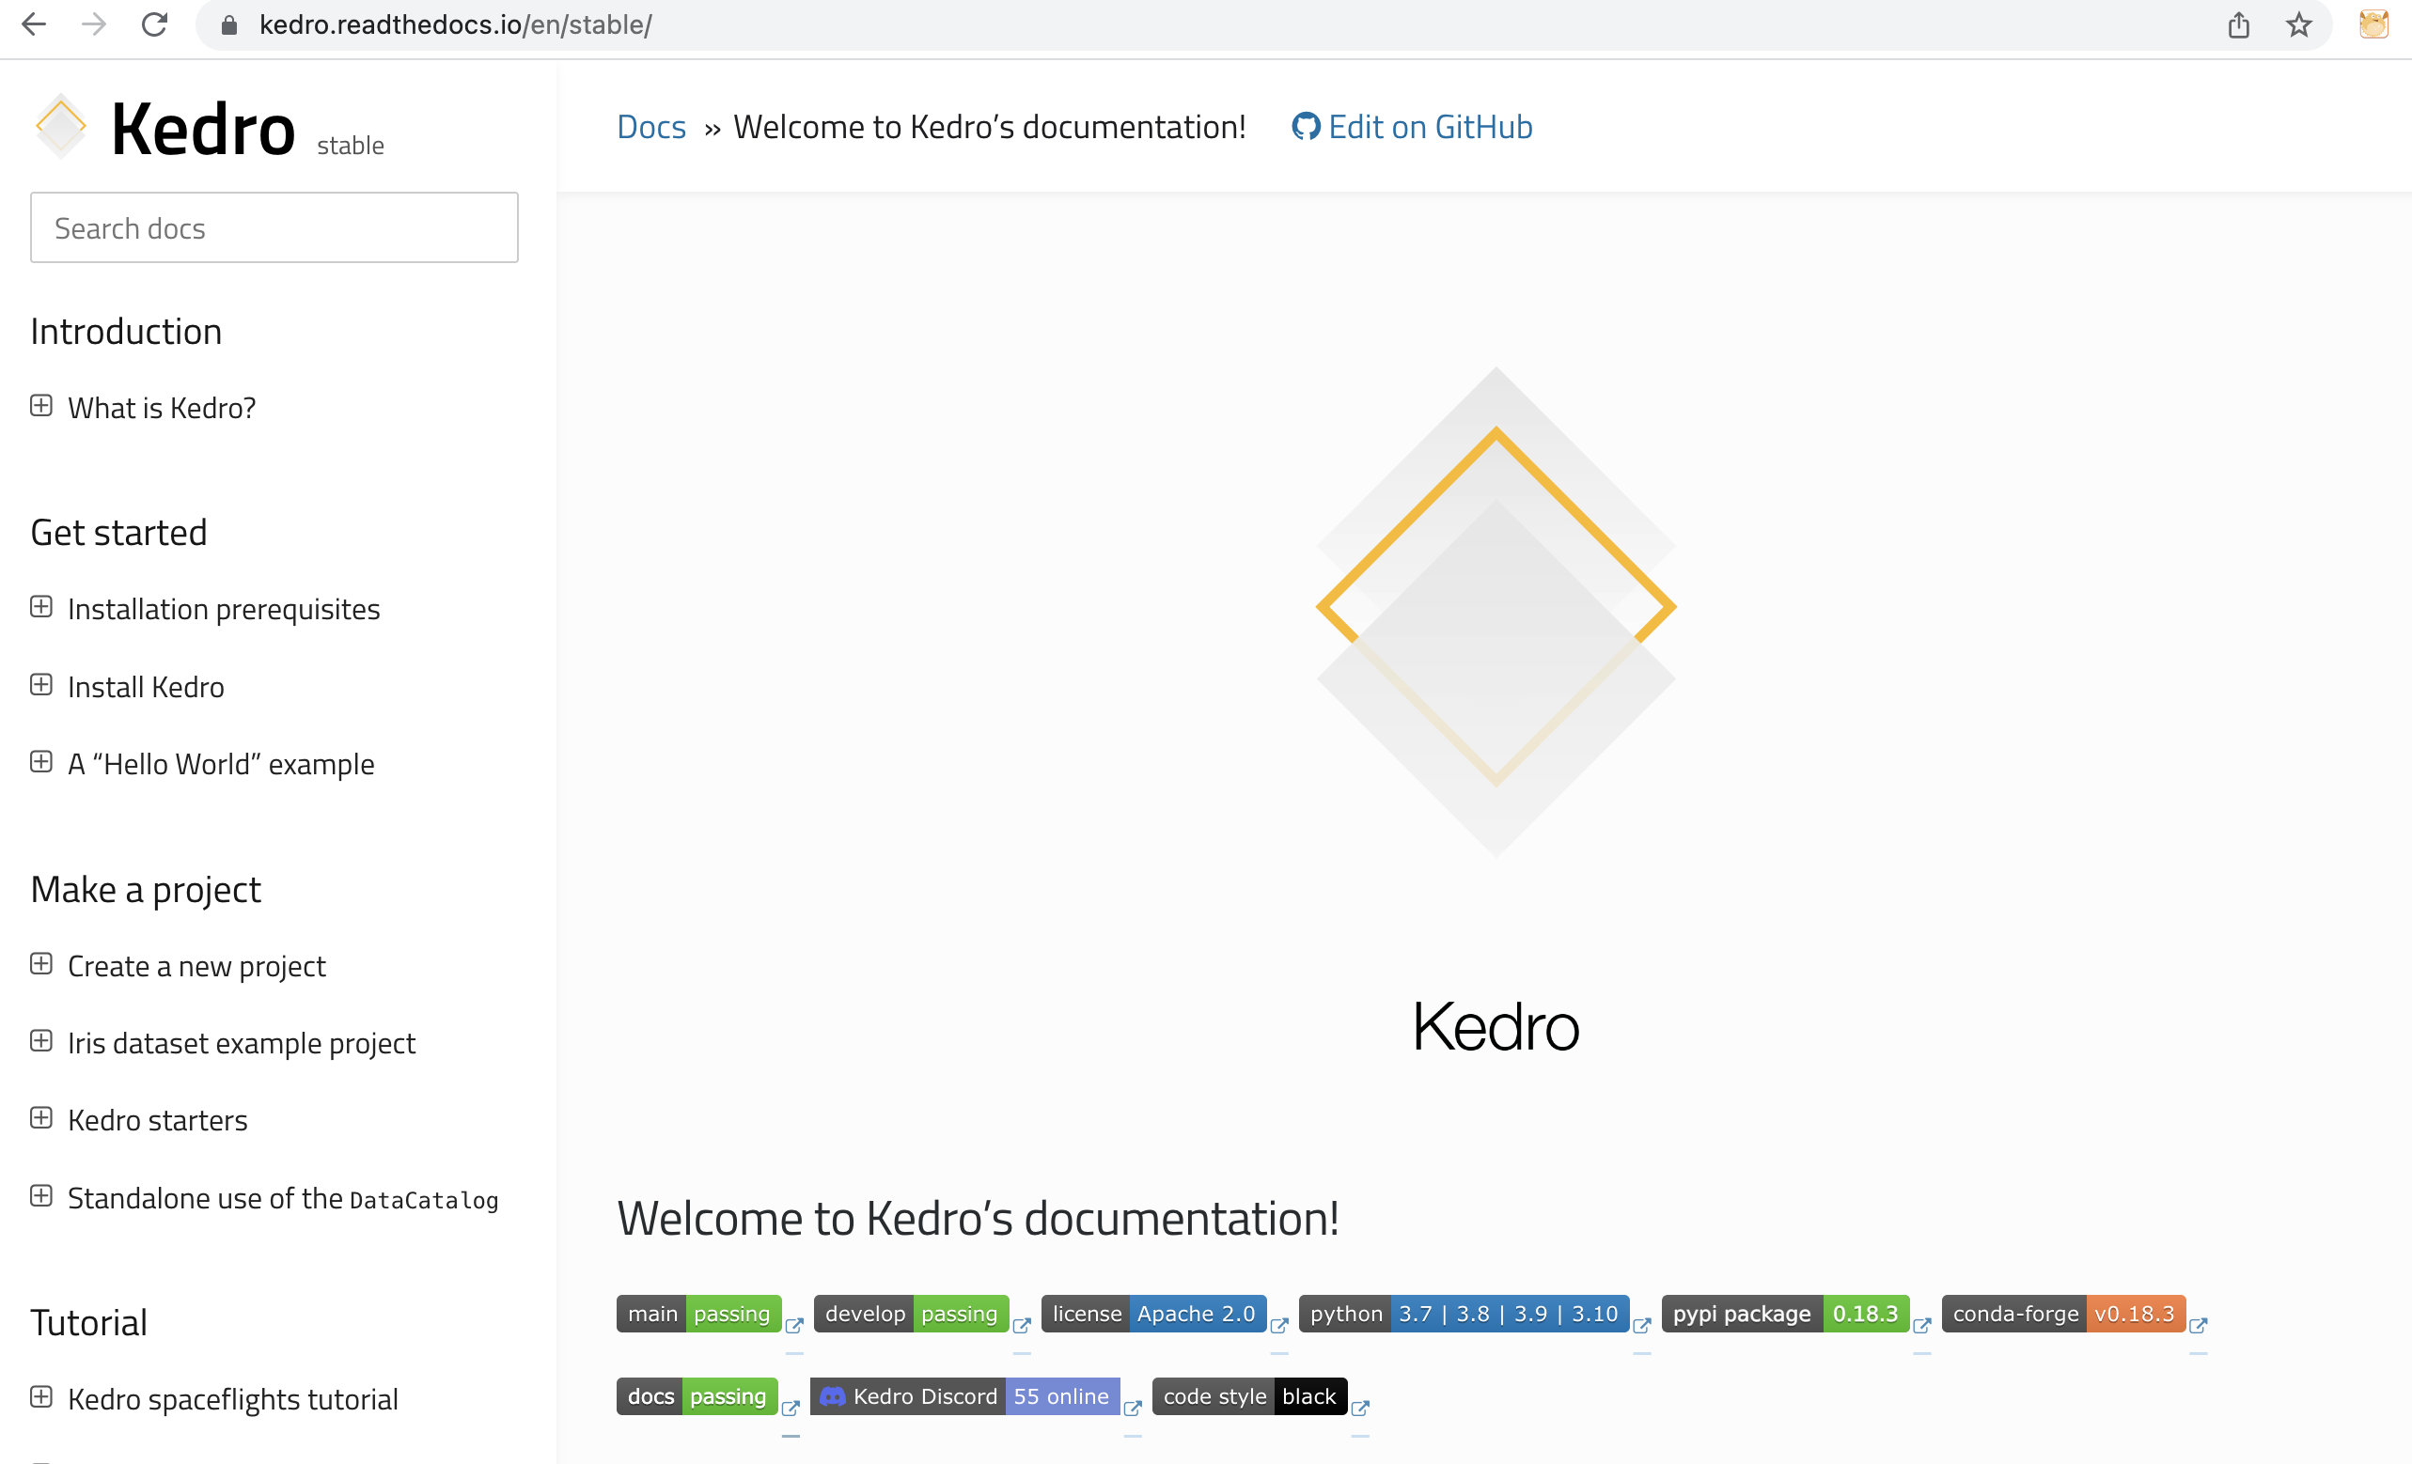

Slide 5
4. Package the project
1. Set-up project
2. Set-up data
3. Create pipeline

Slide 6
Set-up project
Set-up data
Create pipeline
Package project
Create a new project
Install dependencies
Configure the project
Add data
Register the datasets
Create pipeline template
Create nodes
Assemble nodes into the pipeline
Test and visualize
Persist artifacts
Modularize pipeline
Package
Document
Deploy

Slide 7
Raw
Intermediate
Primary
Data Engineering Convention
Features
Model input
Models
Model output
Reporting

Slide 8
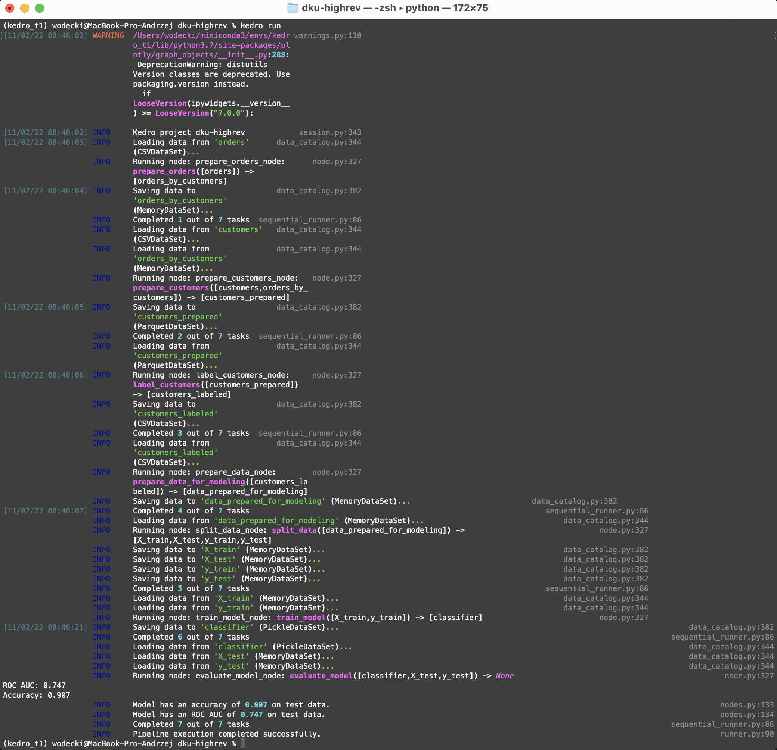
kedro run

Slide 9
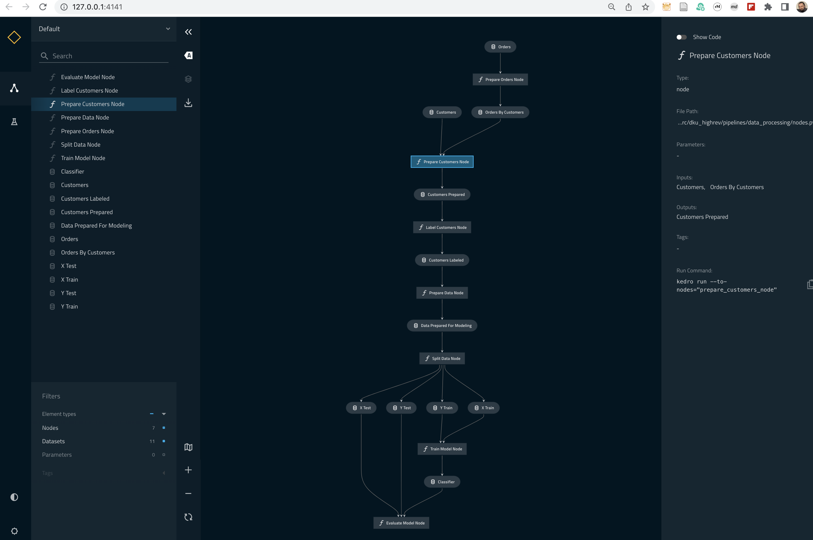
kedro viz

Slide 10


Slide 11
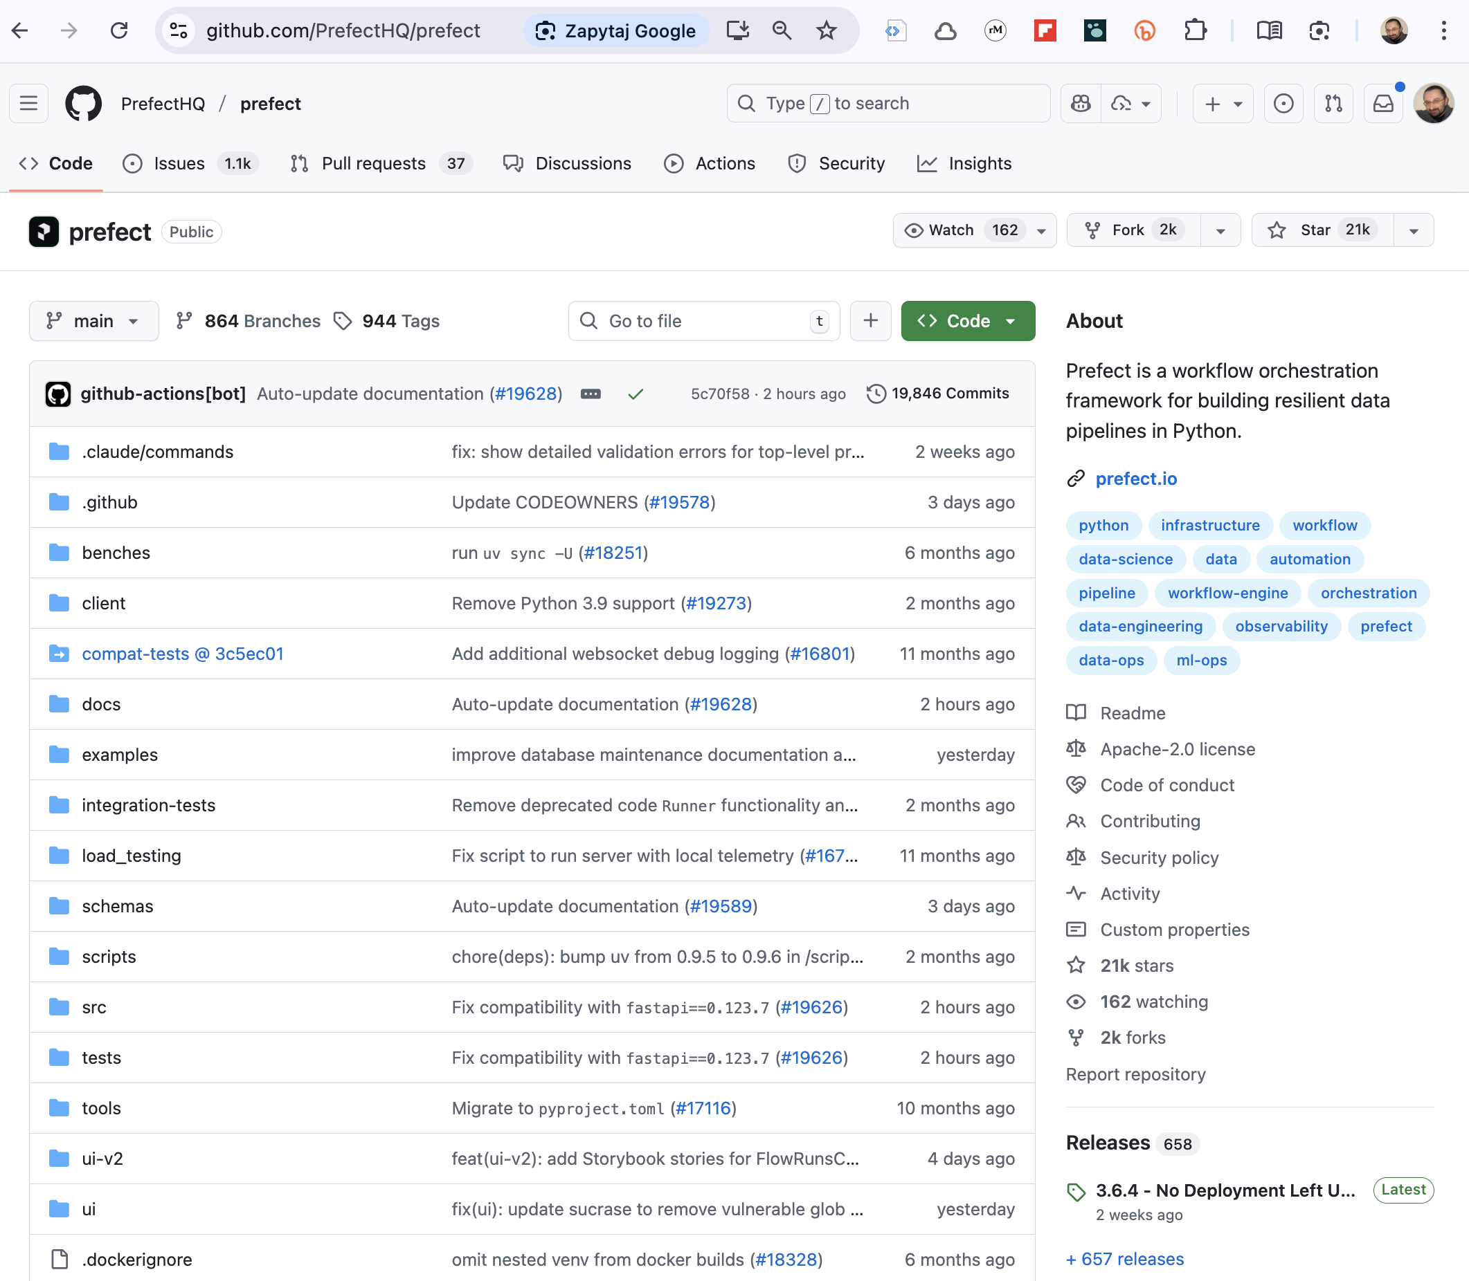

Slide 12
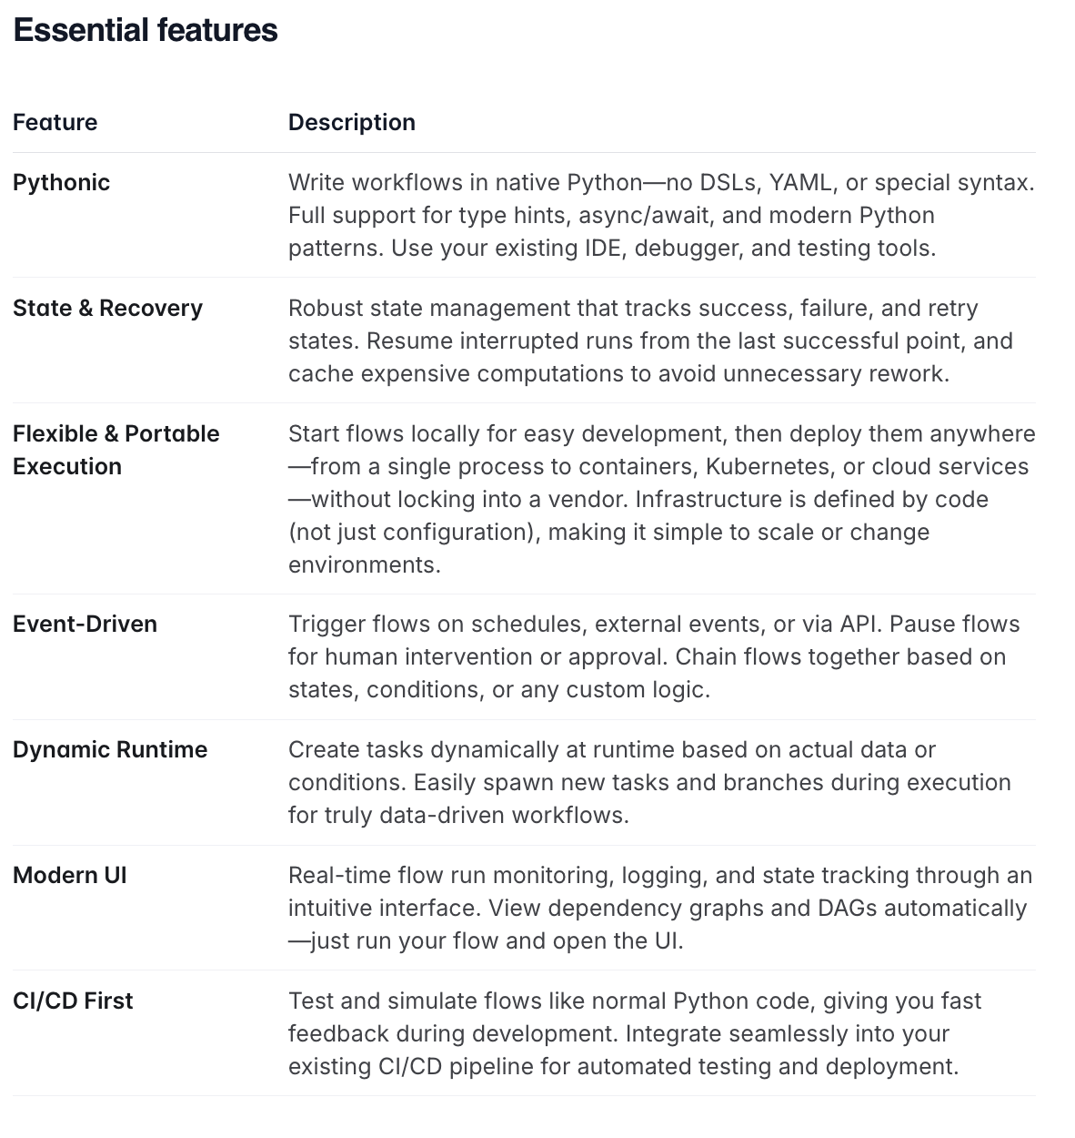

Slide 13
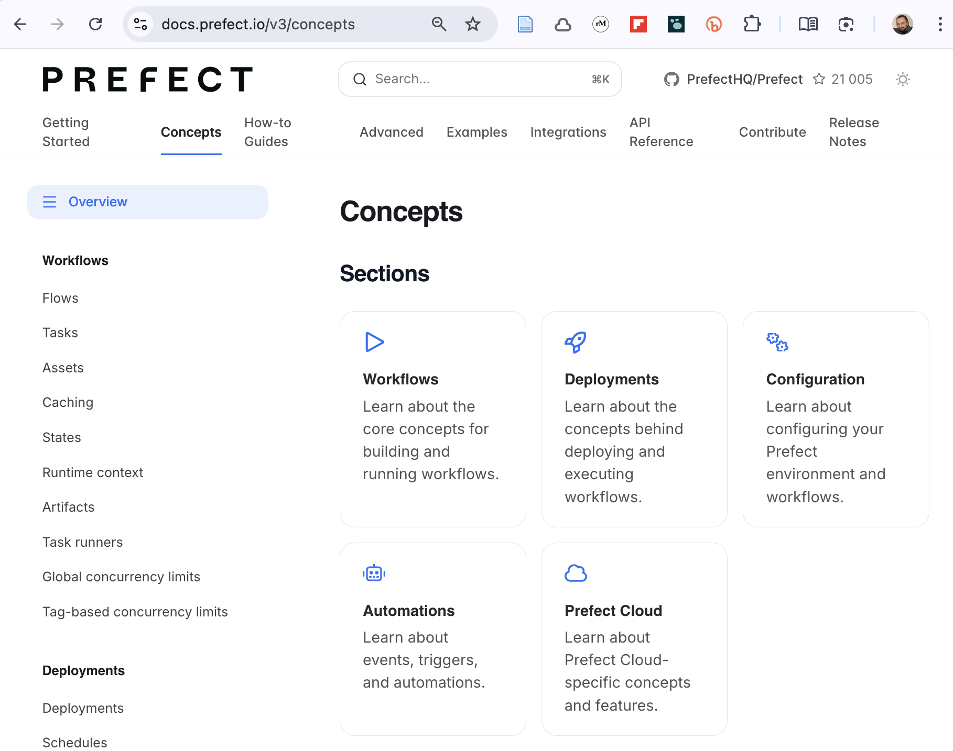

Slide 14
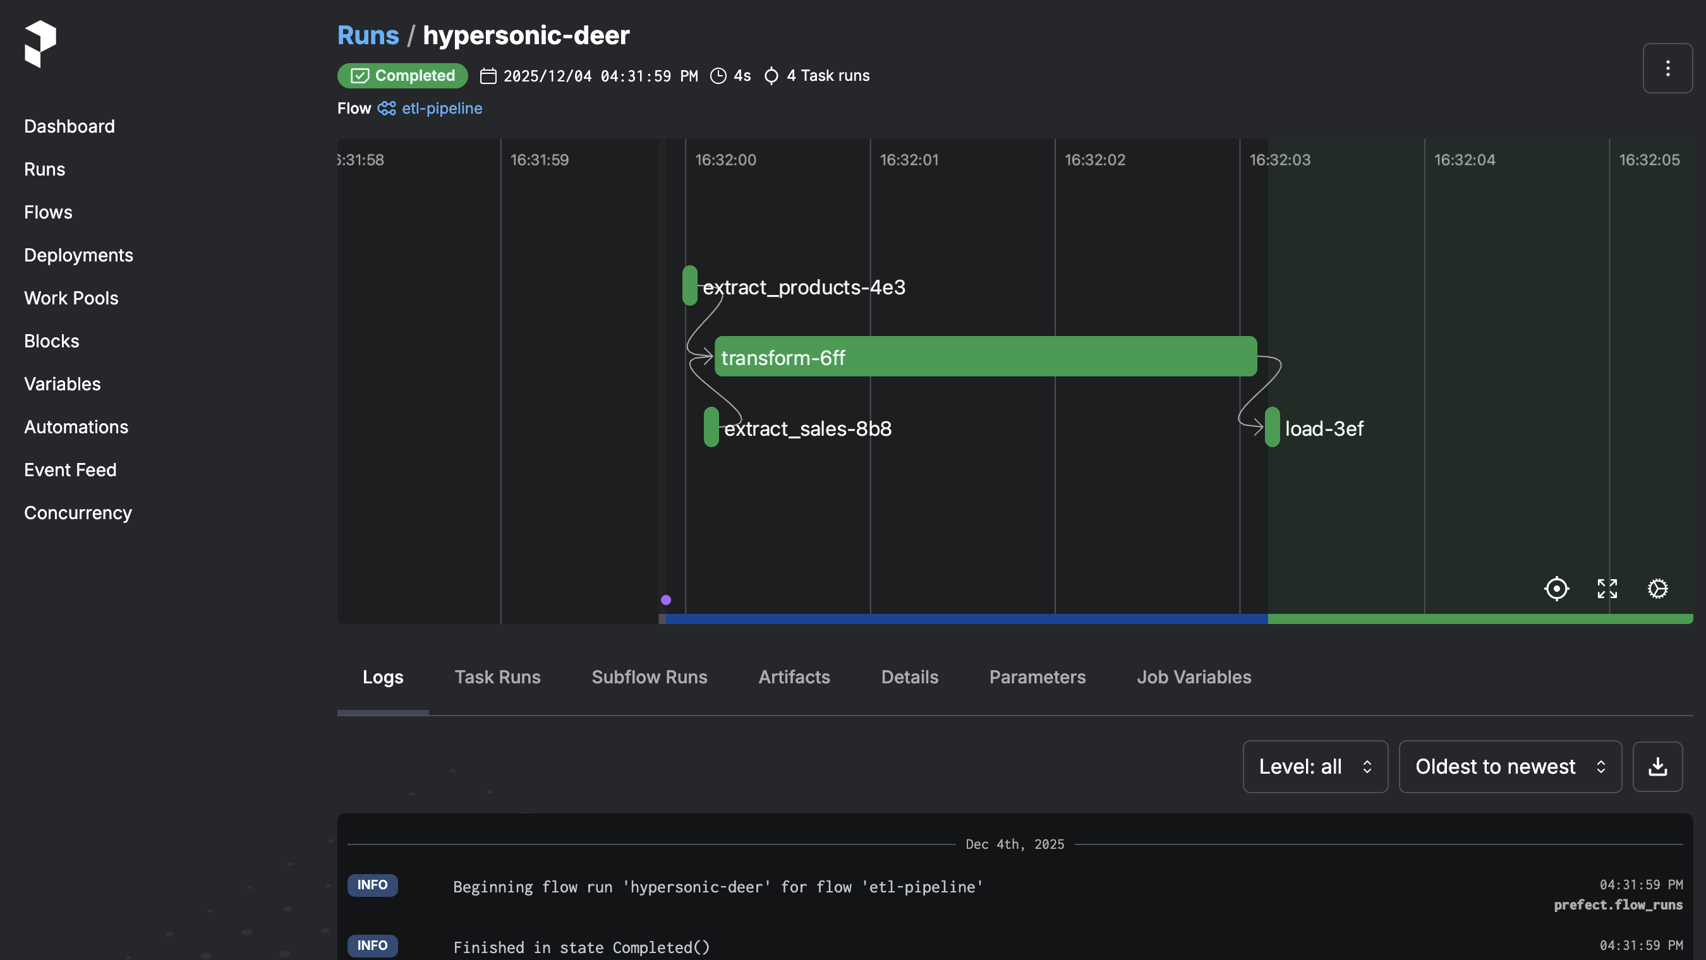

Slide 15
